Slide 1
Literature Introduction
11/06/2021

Slide 2
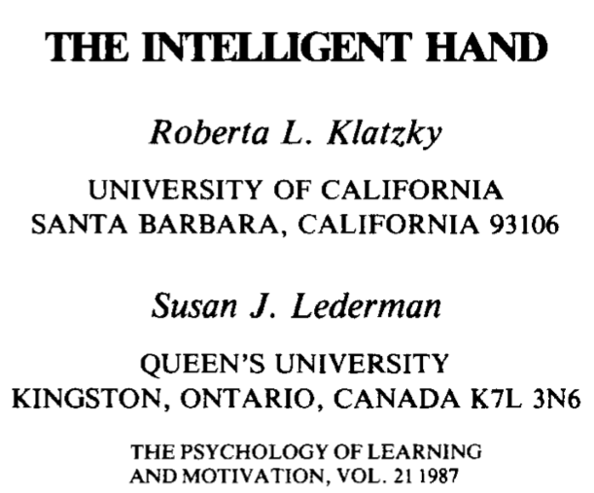
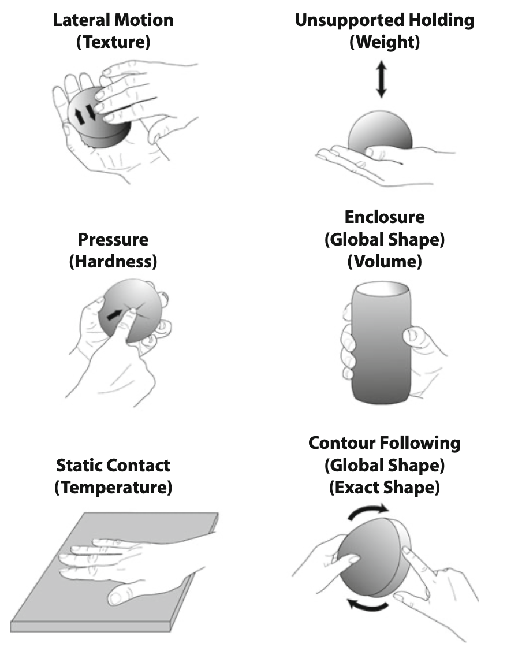
Introduces the concept of Exploratory Procedures (EPs).
Each EP is related to a particular object property.

Slide 3
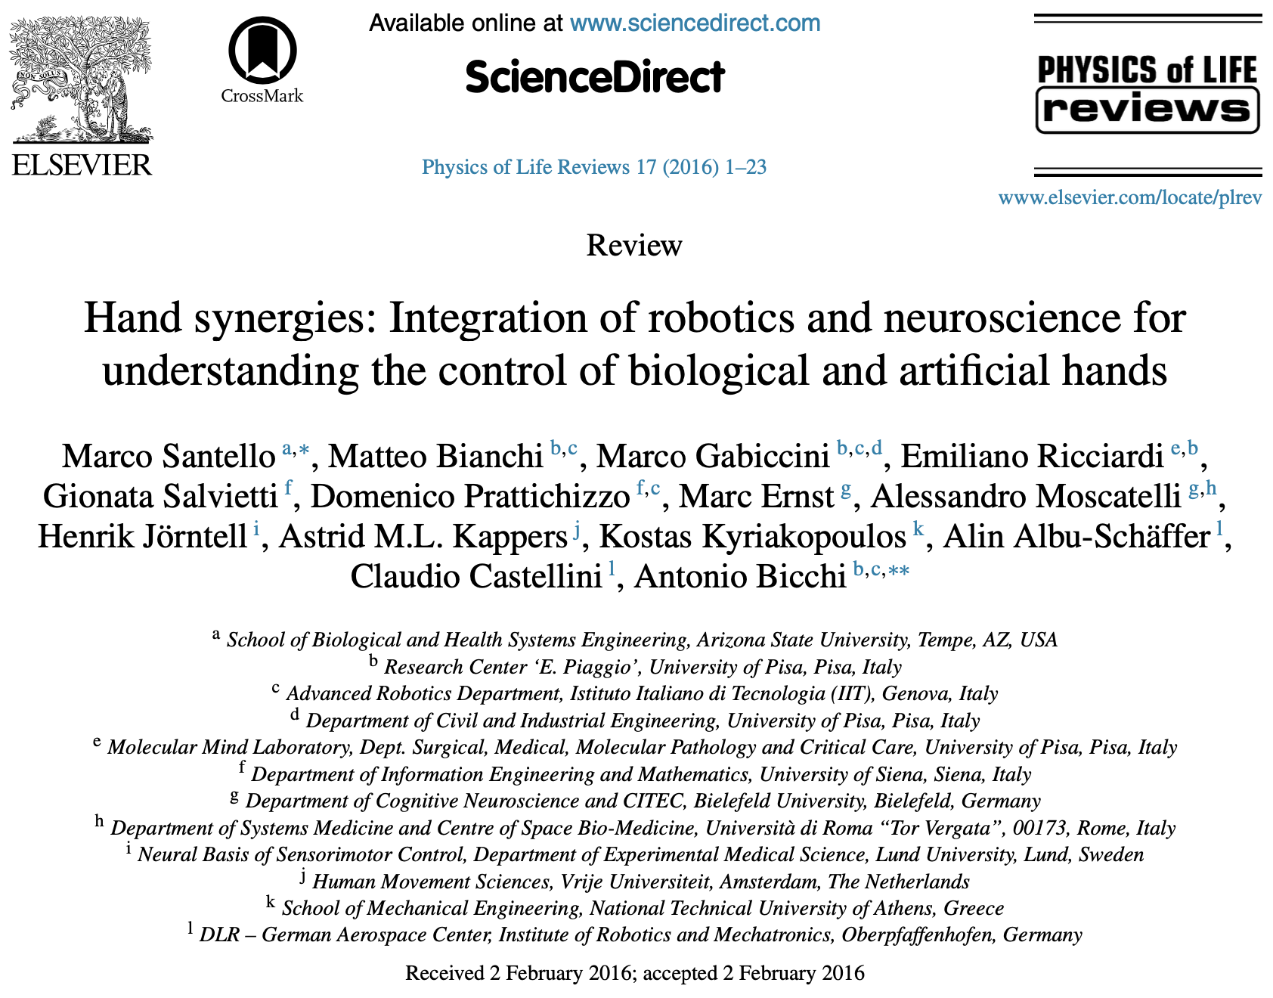
Hand synergies: motor control
“Hand postures used to grasp a wide variety of imagined objects could be described by a very small number of linear combinations of joint angles, i.e. principal components or postural synergies (or eigenpostures)”.
”Lower-order principal components […] are mainly responsible for coarse hand opening and closing – and higher-order principal components corresponding to finer hand shape adjustments”.
“The apparent complexity associated with having to control multiple digit joints might be addressed by constraining them to move in a synergistic fashion. […] The problem of controlling many joints is not as complex as it seems”.

Slide 4
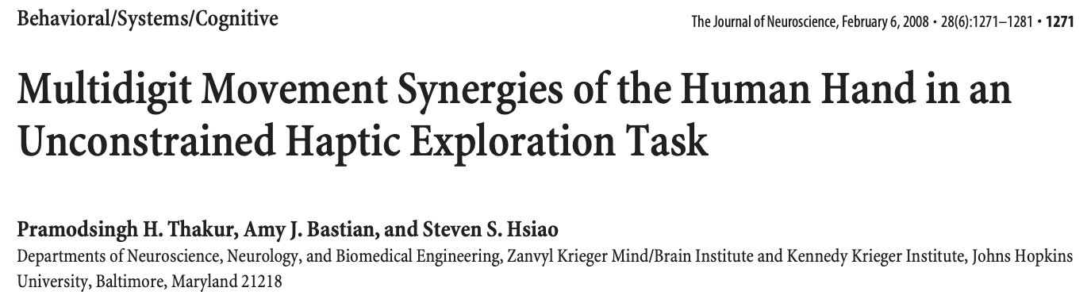
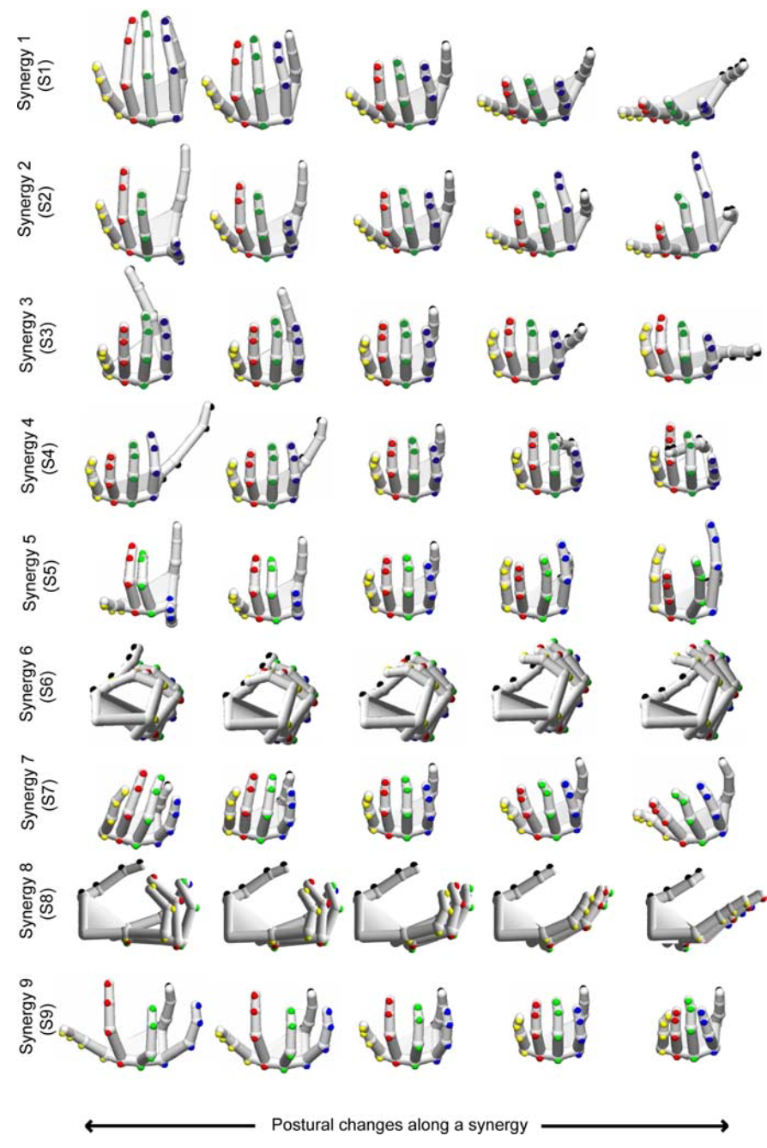
8 blinfolded subjects perform a haptic exploration task to identify fifty common objects using only one hand.
For each subject they perform Principal Component Analysis and select the 10 eigenvectors corresponding to the 10 higher eigenvalues.
“The 10 sets of hand postures corresponding to the 10 eigenvectors for each subject were visually compared across different subjects to identify similar trends. Those with similarities across multiple subjects were considered to belong to a common synergy”.
”Any posture can be considered as a unique point in this 9D space. Similarly, any exploratory movement can be considered as a trace or curve meandering inside this 9D space”.

Slide 5
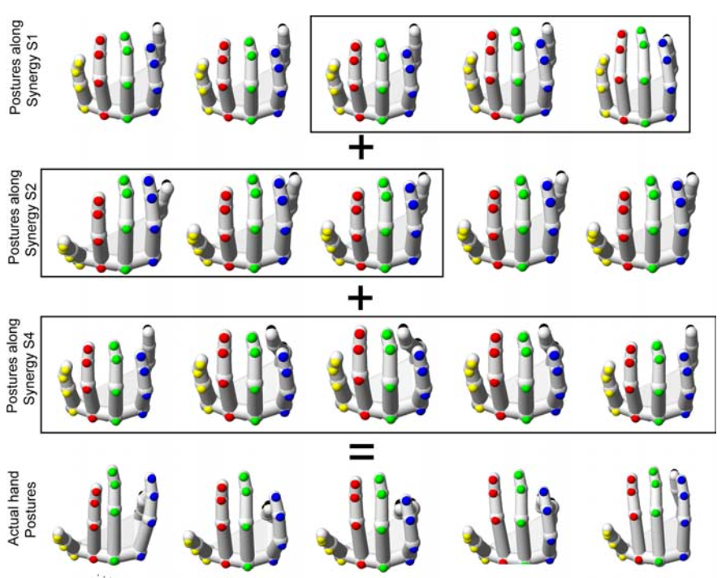
“Any hand movement can be thought of as a combination of postural changes along contributing synergies. […] The synergies can be thought of as building blocks that contribute in varying proportions to construct any arbitrary hand movement patterns“.
“Because synergies combine in various ways to construct any continuous segment of hand motion, they can be thought of as building blocks of Exploratory Procedures”.
Flaws: Synergies are calculated for each subject and paired manually.

Slide 6
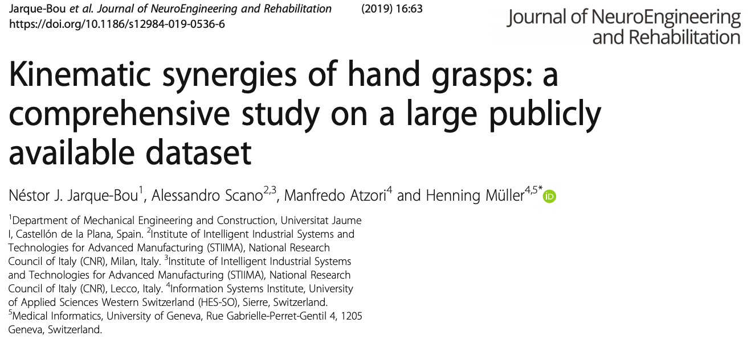
Here synergies are also computed for each subject using PCA.
Those synergies are grouped using a hierarchical cluster analysis.

Slide 7
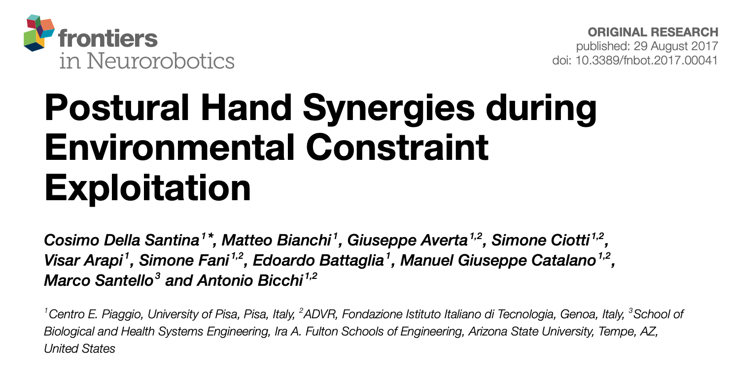
In this paper they compute hand synergies under two different conditions: with and without cutaneous (tactile) impairment.
For the cutaneous impairment, participants were requested to wear rigid shels at their fingertips.
They conclude that “the presence of tactile impairment, while modifying the strategies themselves, does not substantially modify the most basic kinematic ingredients commonly used to generate hand postures. […] Cutaneous impairment affects posture refinement, which can be likeliy ascribed to higher order synergies”.

Slide 8
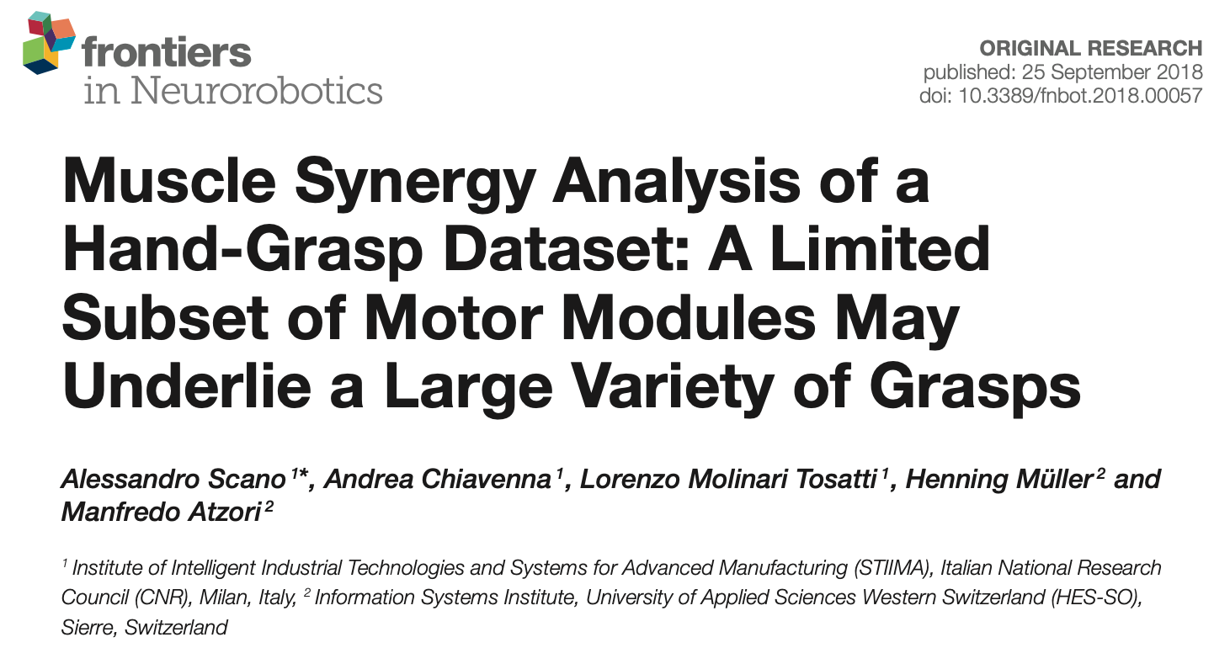
Authors extract muscle synergies from sEMG data using non-negative matrix factorization (NMF).
They group the synergies using k-means clustering algorithm.

